Slide 1
TESLA STOCK PRICE PREDICTION
USING DEEP LEARNING (SimpleRNN & LSTM)
DOMAIN – FINANCIAL ANALYTICS
Presented By
KEERTHANA A

Slide 2
OVERVIEW
Problem & Dataset
Data Cleaning & EDA
Feature Prep & Sequencing
SimpleRNN & LSTM Models
Tuning & Forecasting
NLP Sentiment & Conclusion

Slide 3
PREDICTING TESLA’S CLOSING PRICE
Build deep learning models that learn from Tesla's historical price history and forecast the Adjusted Close price 1, 5, and 10 days into the future — then compare SimpleRNN against LSTM to see which architecture generalizes better.
7
2010-2020
Column: Date,Open,High,Low , close, Adj close, Volume
Data range covered
2,416
0
Daily records
Missing Values /
duplicates found
Clean & explore the daily OHLCV data (2010–2020)
Engineer a 60-day sliding window as model input
Train SimpleRNN and LSTM for 3 forecast horizons
Tune hyperparameters with GridSearchCV
Add an NLP layer: headline sentiment vs. returns
2

Slide 4
DATA CLEANING & PREPARATION
Checked integrity
isnull().sum() and duplicated().sum() confirmed zero missing values and zero duplicate rows in TSLA.csv.
1
Simulated missing-value strategy
On a copy, injected artificial NaNs and resolved them with forward-fill + linear interpolation — the right approach for sequential price data.
2
Datetime indexing
Converted Date to datetime, sorted chronologically, and set it as the DataFrame index.
3
Target selection
Adj Close chosen as the prediction target followed by project specifications.
4

Slide 5
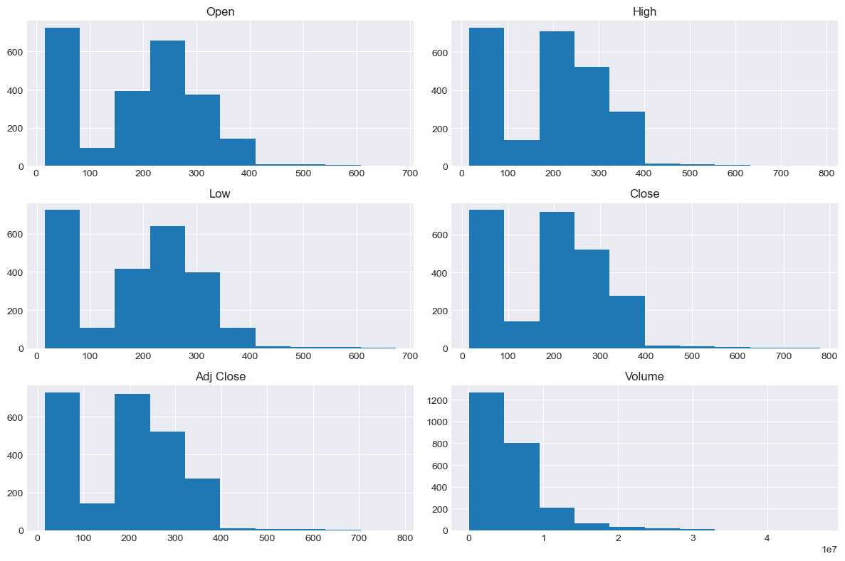
UNIVARIATE ANALYSIS – FEATURE DISTRIBUTION
OBSERVATIONS
Price features show similar distributions.
Most prices are concentrated in lower ranges.
Volume is strongly right-skewed.
Long tails indicate high-value observations.
Histograms showing the distribution of Open, High, Low, Close, Adj Close, and Volume features.

Slide 6
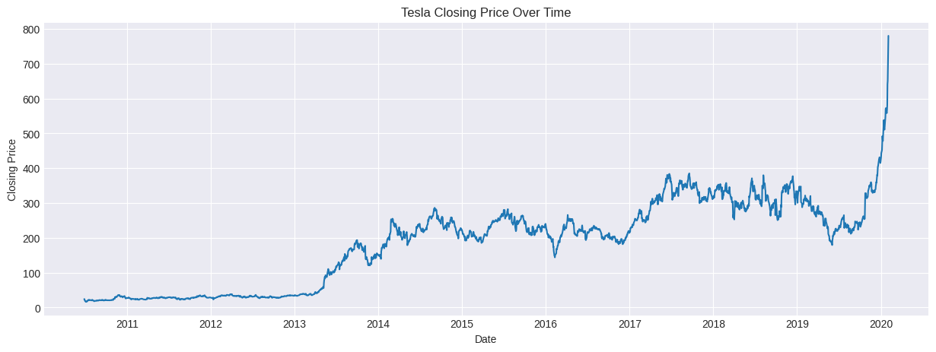
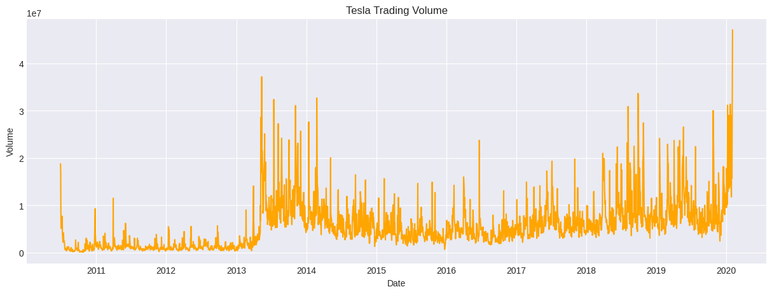
BIVARIATE ANALYSIS- PRICE TREND & TRADING VOLUME
Observations
Strong long-term price growth
Higher volume spikes during major movements
Increased volatility in later years

Slide 7
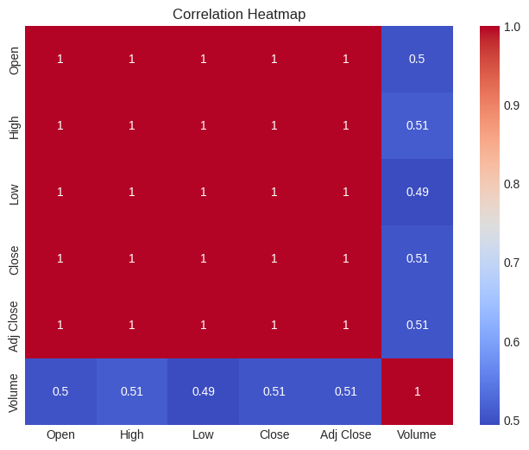
MULTIVARIATE ANALYSIS – CORRELATION HEAT MAP
Open, High, Low, Close & Adj Close: very strong correlation (~1.0)
Volume: moderate correlation with price features (~0.49–0.51)
Price variables: highly interrelated

Slide 8
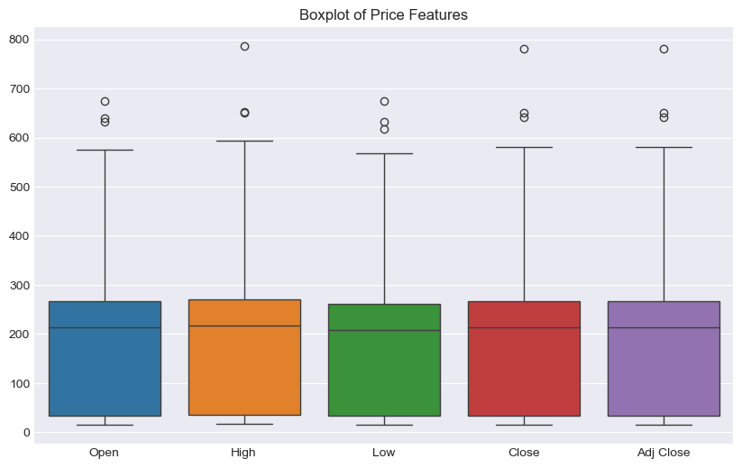
OUTLIER ANALYSIS
Outliers are present across price features.
High and Adj Close show notable extreme values.
Outliers represent unusually high historical prices.

Slide 9
FEATURE PREPARATION – SCALING & SEQUENCE CREATION
80 / 20 Split
MinMaxScaler
60-Day Window
3 Horizons
Chronological train/test split — no shuffling, since future data must never leak into training.
Fit strictly on the training set, then applied to both train and test — prevents data leakage.
Each input sequence uses the past 60 days of scaled price to predict the target day.
Separate X/y sequence sets built for 1-day, 5-day, and 10-day ahead targets.
Train size: 1,872 sequences | Test size: 484 (1-day) / 480 (5-day) / 475 (10-day)

Slide 10
SimpleRNN vs LSTM Architecture
SimpleRNN | LSTM
SimpleRNN(64) return_sequences=True | LSTM(64) return_sequences=True
Dropout(0.2) | Dropout(0.2)
SimpleRNN(32) | LSTM(32)
Dropout(0.2) | Dropout(0.2)
Dense(1) | Dense(1)
Both compiled with Adam optimizer + Mean Squared Error loss · trained with EarlyStopping & ModelCheckpoint

Slide 11
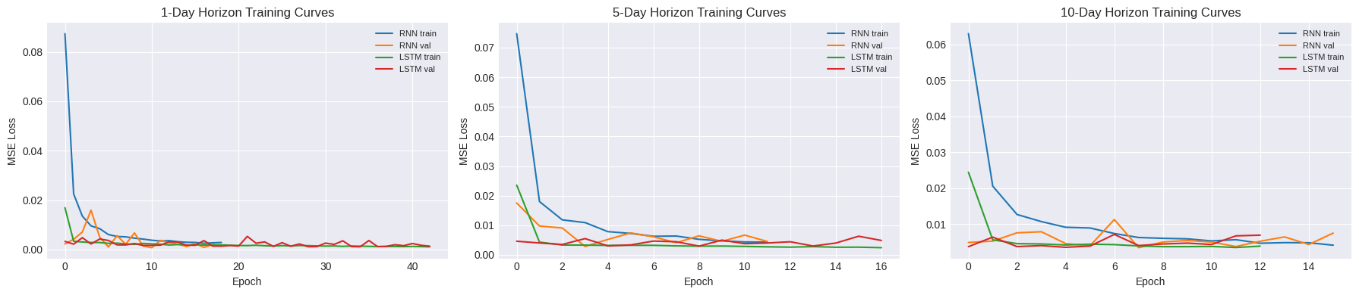
TRAINING CURVES - All 3 HORIZONS
Early stopping halted training once validation loss stopped improving — 6 models trained in total (2 architectures × 3 horizons).

Slide 12
TEST-SET PERFORMANCE (MSE / RMSE / MAE)
Model | Horizon | MSE | RMSE | MAE
SimpleRNN | 1-day | 733.53 | 27.08 | 14.59
LSTM | 1-day | 699.77 | 26.45 | 18.06
SimpleRNN | 5-day | 1,654.21 | 40.67 | 26.01
LSTM | 5-day | 1,787.55 | 42.28 | 29.00
SimpleRNN | 10-day | 2,196.60 | 46.87 | 33.19
LSTM | 10-day | 2,611.48 | 51.10 | 33.70
Lower RMSE = better. Result is mixed by horizon: LSTM wins at 1-day, SimpleRNN wins at 5-day and 10-day — see Slide 15.
14

Slide 13
MODULE EVALUATION — MSE / RMSE / MAE
Model | Horizon (days) | MSE | RMSE | MAE
0 | LSTM | 1 | 699.768235 | 26.453133 | 18.057598
1 | SimpleRNN | 1 | 733.527663 | 27.083716 | 14.586979
2 | LSTM | 5 | 1787.551161 | 42.279441 | 29.000186
3 | SimpleRNN | 5 | 1654.211900 | 40.672004 | 26.012925
4 | LSTM | 10 | 2611.477419 | 51.102617 | 33.703618
5 | SimpleRNN | 10 | 2196.599926 | 46.867899 | 33.194465
OBSERVATION
1-Day: LSTM performs better with lower RMSE (26.45 vs 27.08).
5-Day: SimpleRNN performs better (40.67 vs 42.28).
10-Day: SimpleRNN performs better (46.87 vs 51.10).
Results are mixed by horizon: LSTM has lower RMSE at 1-day, while SimpleRNN has lower RMSE at 5-day and 10-day.

Slide 14
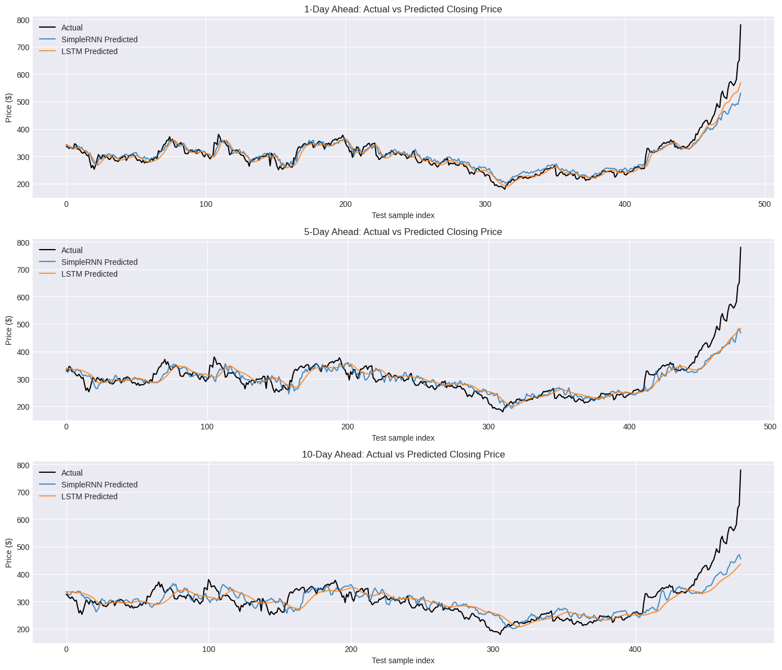
ACTUAL vs PREDICTED CLOSING PRICE
OBSERVATION
1-Day: Predictions closely follow actual prices.
5-Day: Slightly higher prediction error.
10-Day: Error increases as forecast horizon grows.
Overall: SimpleRNN tracks the actual trend better than LSTM.

Slide 15
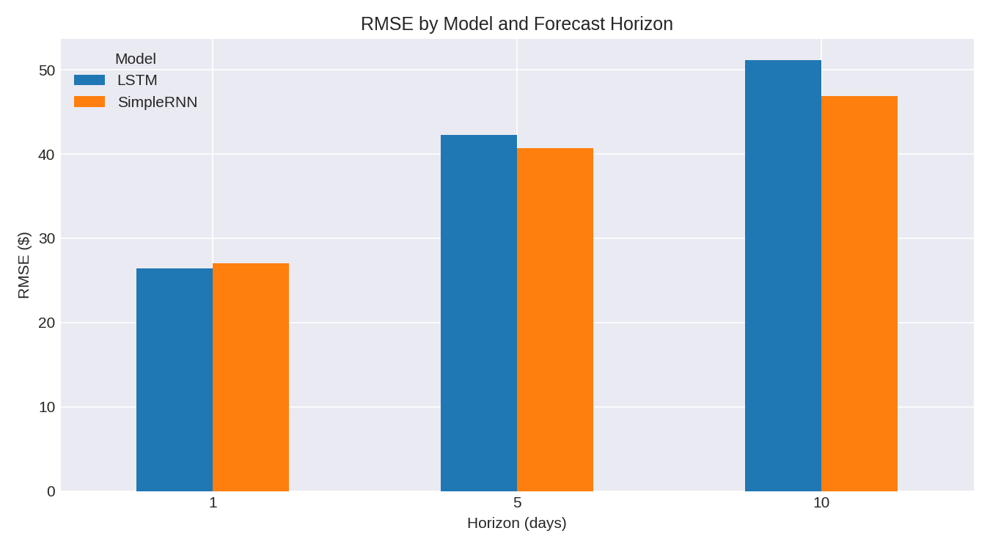
MODEL COMPARISON — RMSE BY HORIZON
OBSERVATION
1-Day: LSTM has lower RMSE.
5-Day: SimpleRNN has lower RMSE.
10-Day: SimpleRNN has lower RMSE.
Overall: Mixed — LSTM wins at 1-day, SimpleRNN wins at 5-day and 10-day.
No single model dominates every horizon on this run — performance varies by forecast window.

Slide 16
GridSearchCV on the LSTM (1-day)
Grid searched over units, dropout, and learning rate (2×2×2 = 8 combinations, cv = 2):
Units | Dropout | Learning Rate | Mean CV Score (neg MSE) | Rank
64 | 0.3 | 0.005 | -0.002035 | 1 (Best)
32 | 0.3 | 0.005 | -0.002115 | 2
64 | 0.2 | 0.001 | -0.002553 | 3
64 | 0.3 | 0.001 | -0.003327 | 4
TUNED LSTM (1-DAY)
TBD
RMSE — best params: 64 units, 0.3 dropout, lr = 0.005
vs. untuned LSTM baseline: 26.45 RMSE
Retrained with the new best params — final tuned RMSE pending re-run confirmation.
17

Slide 17
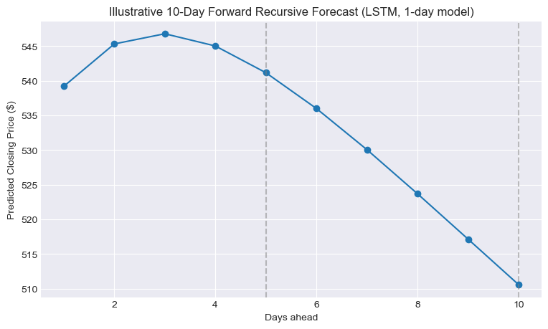
10-Day Forward Recursive Forecast
Using the tuned 1-day LSTM recursively — each predicted day feeds back in as input for the next.

Slide 18
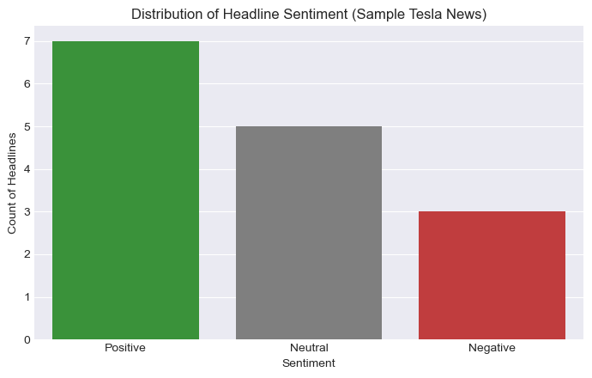
News Headline Sentiment Analysis
15 real Tesla headlines (2013–2020) cleaned and scored with VADER SentimentIntensityAnalyzer:
Correlation: Sentiment vs. Same-Day Return
0.31
Moderate positive correlation — positive news headlines tend to line up with positive same-day stock movement.

Slide 19
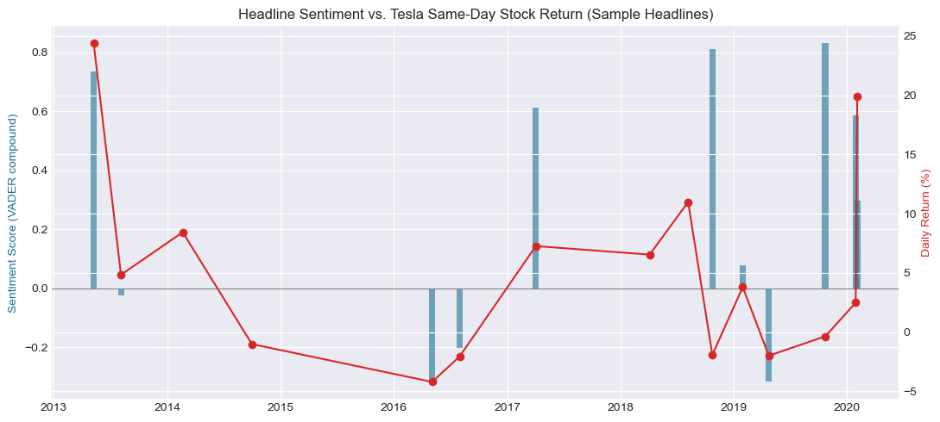
Headline Sentiment vs. Stock Return
Positive-sentiment headlines (e.g. record profit, delivery beats) cluster with days of positive stock return.

Slide 20
BUSINESS USE CASES
Automated Trading
Supports buy/sell decision making.
Can be integrated with trading systems.
Risk Management
Helps estimate future price movement.
Assists in portfolio risk analysis.
Investment Planning
Supports short- and medium-term investment decisions.
Useful for portfolio allocation.
Research & Analysis
Serves as a baseline for comparing advanced forecasting models.

Slide 21
CONCLUSION
Which Model Wins?
BEST AFTER TUNING
OUT-OF-THE-BOX WINNER
Tuned LSTM
Mixed Results
LSTM has lower RMSE at 1-day (26.45 vs 27.08); SimpleRNN has lower RMSE at 5-day and 10-day (40.67 vs 42.28, 46.87 vs 51.10).
GridSearchCV selected 64 units, 0.3 dropout, lr=0.005 (best CV score -0.002035) — final retrained RMSE pending confirmation.
On this run, no single model wins every horizon — LSTM edges ahead at 1-day, SimpleRNN at 5-day and 10-day. This kind of run-to-run variation is expected with neural network training. Adding news sentiment as an extra input channel remains the clear next step.
21

Slide 22
INSIGHTS & CONCLUSION
Key Insights
Results are mixed by horizon — LSTM has the lower RMSE at 1-day, while SimpleRNN has the lower RMSE at 5-day and 10-day.
Prediction accuracy decreases as the forecast horizon increases — 10-day forecasting is more challenging than 1-day forecasting.
LSTM tuning results are pending, using the new best params (64 units, 0.3 dropout, lr=0.005) from GridSearchCV.
Recursive forecasting can capture the general trend but becomes less reliable further into the future.
Conclusion
No single model dominates every horizon on this run; LSTM performs best short-term (1-day) while SimpleRNN performs best further out (5-day, 10-day). Future work can combine stock data with news sentiment to further improve forecasting accuracy.

